Slide 1
CND212: Digital Testing and Verification

Slide 2
Packages

Slide 3
SystemVerilog - Packages
Packages provide a systematic mechanism for sharing parameters, data, function, tasks, types, property to other interfaces, programs, or modules.
A package can be made accessible within the interface, program, module, and other packages using an import keyword followed by scope resolution operator:: and what has to be imported. An import mechanism provides controlled access based on what is imported
Items in the package cannot have hierarchical references.
They are explicitly named scopes appearing at the same level as top-level modules or primitives.

Slide 4
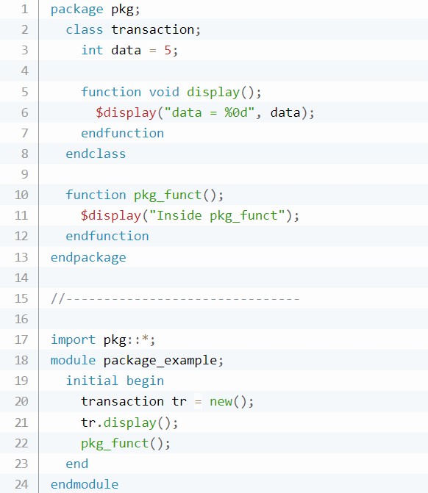

SystemVerilog – Packages – Example1

Slide 5
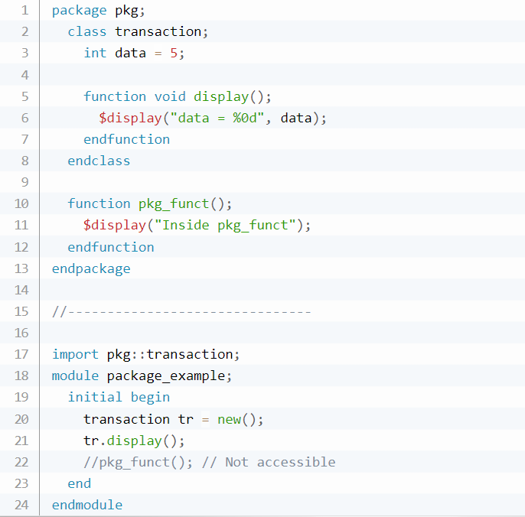

SystemVerilog – Packages – Example 2

Slide 6
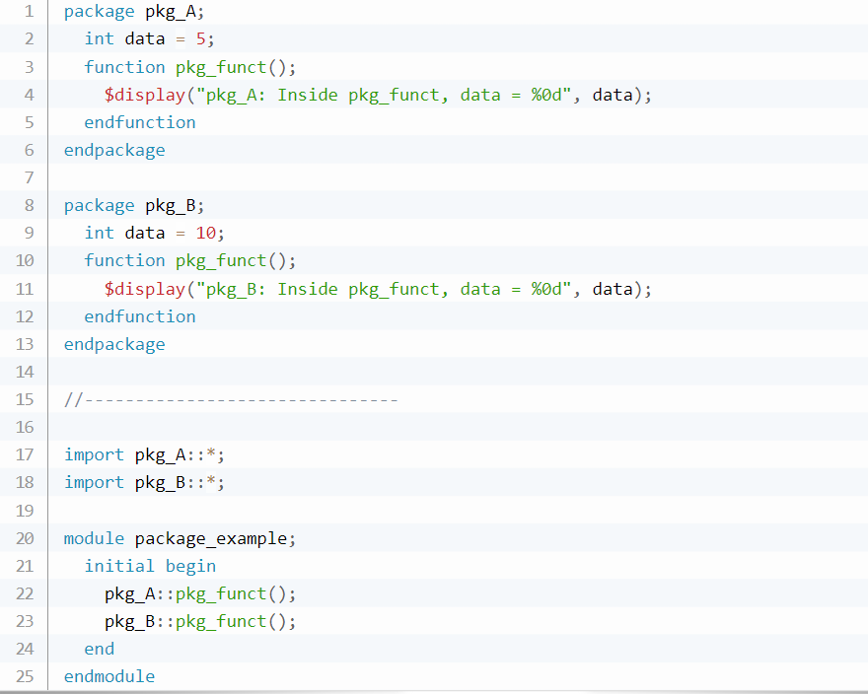

SystemVerilog – Packages – Example 3

Slide 7
SystemVerilog – Key features

Slide 8
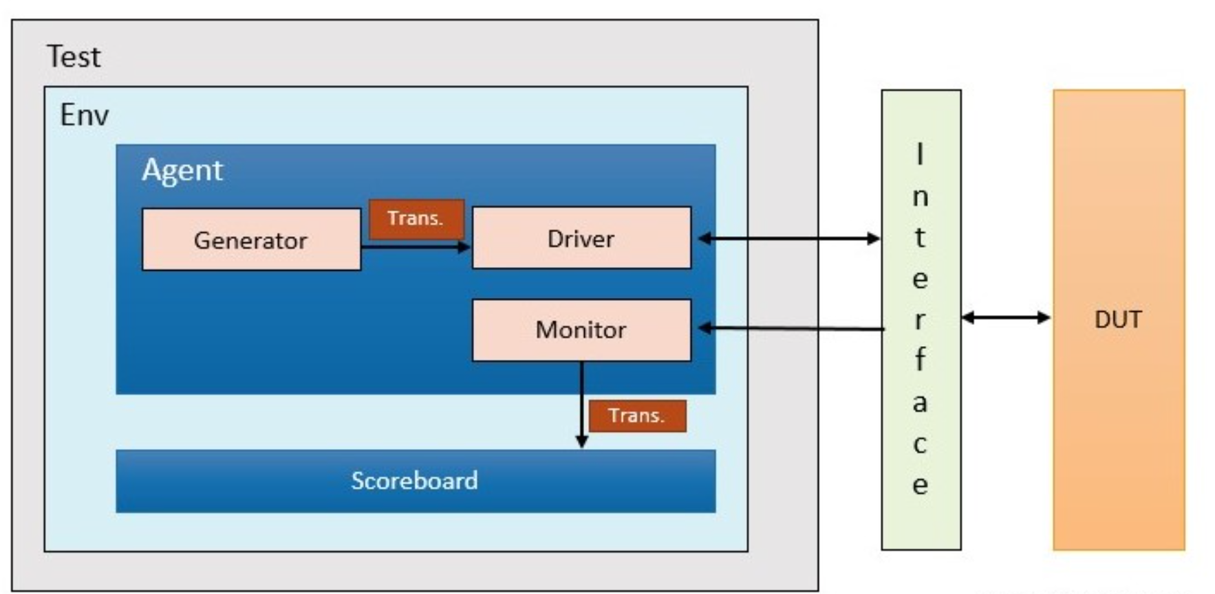
SystemVerilog – Key Features
System Verilog introduces two new design units
The program block
The interface construct

Slide 9
SystemVerilog – Key features 1) The Interface Construct

Slide 10
The interface Construct
Designs have become complicated, and communication between blocks needs to be separated into entities
An interface is a mechanism to connect the testbench to the DUT
It is an intelligent bundle of wires that can be passed just like a port in a port list

Slide 11
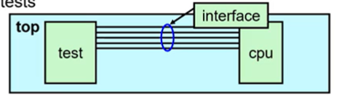
The interface Construct
The interface encapsulates connectivity/communication between the DUT and the testbench:
Connectivity (signals)
Directional information (modports)
Timing (clocking blocks)
Optionally: Functionality (routines, assertions)
Solves multiple problems with traditional connections
Port lists for the connections are compact
Easy to add new connections
Pass DUT connections throughout the testbench

Slide 12

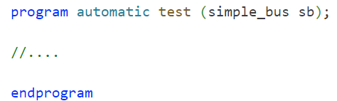
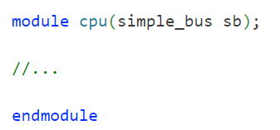
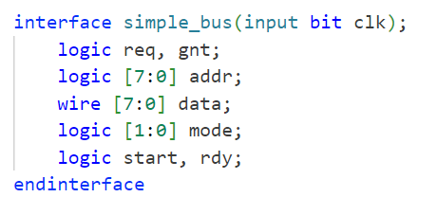
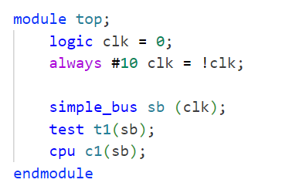
The interface Construct – Example

Slide 13
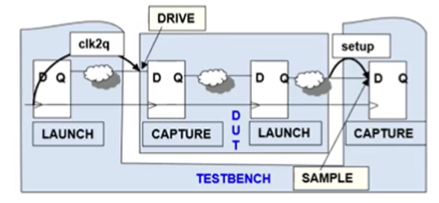
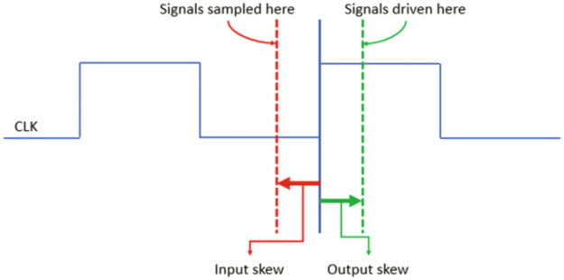
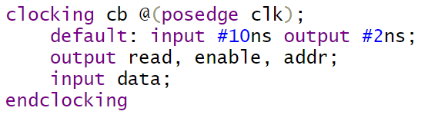
Synchronous Timing: clocking Blocks
Are just for testbench
Emulate the launch and capture of IO of DUT
Create explicit synchronous timing domains
All signals driven or sampled at a clocking event (synchronous)
Interaction between testbench and DUT ideally happens only at clock edges
Specify synchronous signal direction

Slide 14
Signal Access Direction: modport
Enforce signal access and direction using modport
Modports are used for connecting the interface to the test program
In the argument list there should be:
References to the clocking block (if any)
All other asynchronous signals

Slide 15
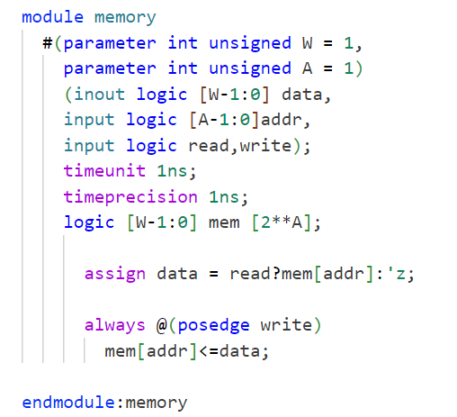
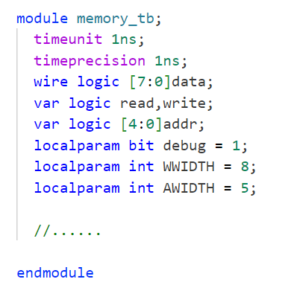
interface + modport – Example
Without using interface
Memory_tb
memory

Slide 16
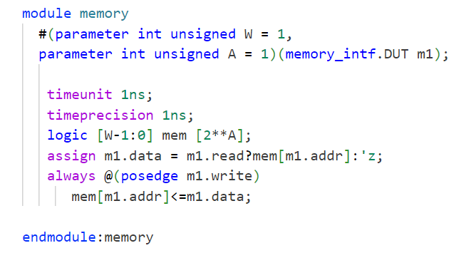
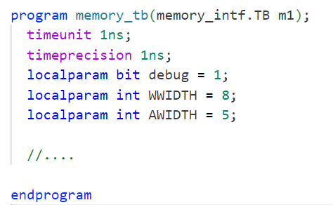
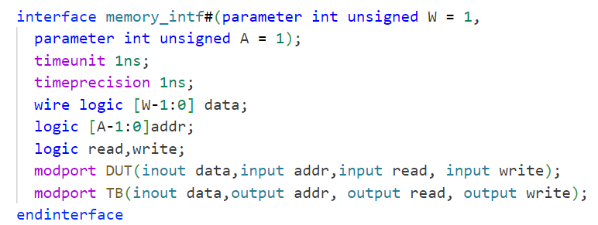
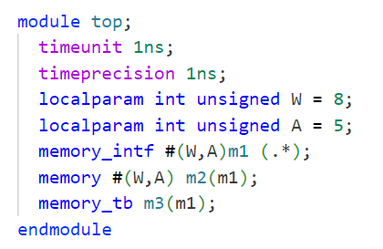
interface + modport – Example
top
With interface
Memory_tb
interface
memory

Slide 17
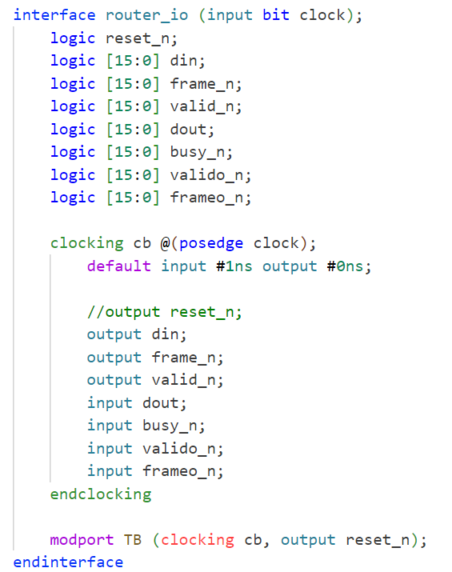
A Complete interface
Signals are declared in the interface body with no direction
Synchronous signals are defined inside the clocking block with their specified direction
A Modport is declared for connectivity and has the arguments for the clocking block and all other asynchronous signals

Slide 18
SystemVerilog – Key features 2) Program Block

Slide 19
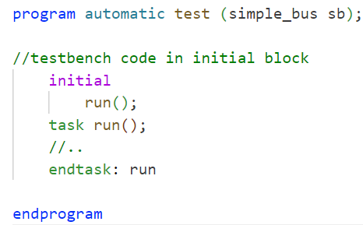
The program Block
The program block is where the testbench code is developed
It is an entry point to test execution
It facilitates a race-free interaction between the design and the testbench

Slide 20
The program Block – timing problems
Problems arise when design and testbench events happen in the same time slot
SystemVerilog introduces a new time slot for testbench execution
Program blocks allow the testbench to execute in a separate time slot (reactive region)
It offers a structured approach to designing and verifying complex systems by effectively managing the execution flow of different elements within a program block.

Slide 21
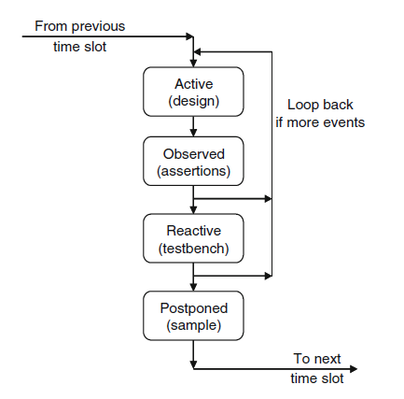
Timing Regions
The execution flow during a time slot consists of four regions:
Preponed region: Samples signals before any changes
Active region: It is responsible for running design events, including RTL and gate code, as well as the clock generator.
Observed region: This region allows for the verification of specific properties and conditions within the design. (Assertions)
Reactive region: The testbench interacts with the design (program).
Postponed region: Read-only phase ($monitor)

Slide 22
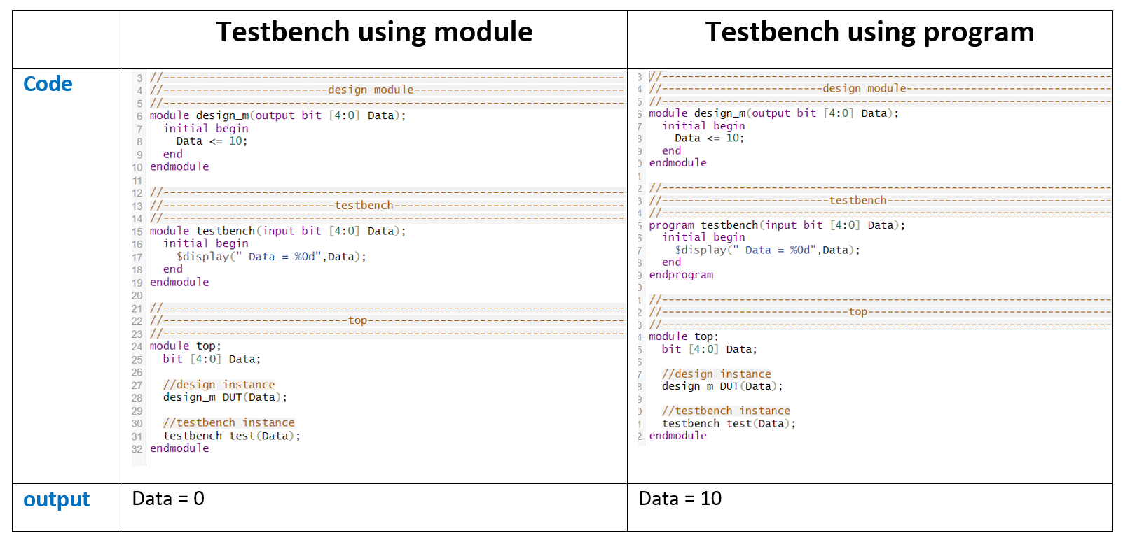
Program vs Module

Slide 23
A Complete Example (Interface + Test Program + Top Level Harness)

Slide 24
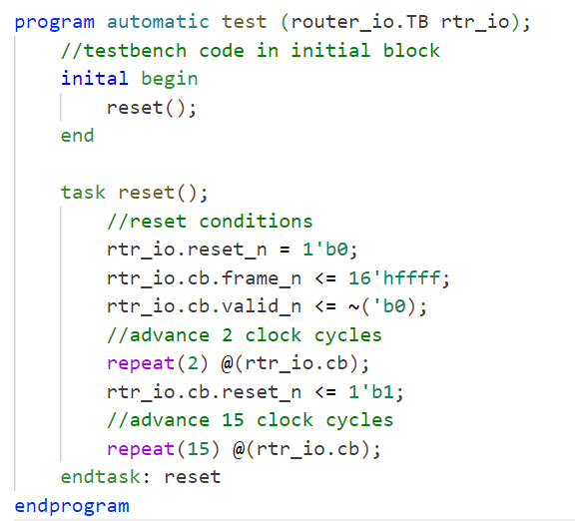
A Complete Example

Slide 25
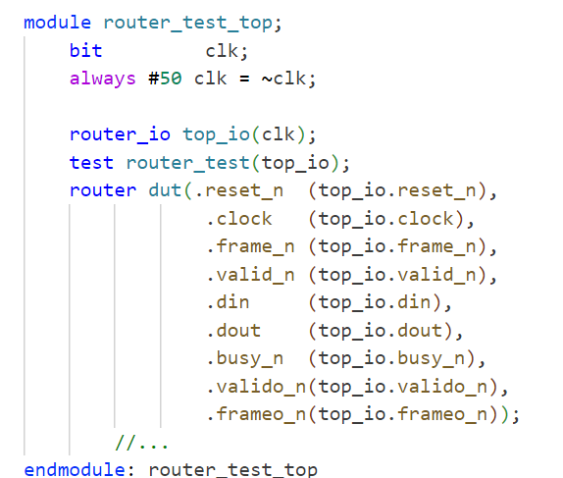
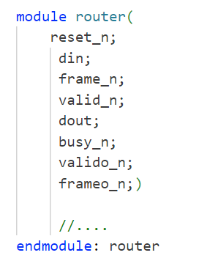
A Complete Example

Slide 26
Lab Task

Slide 27
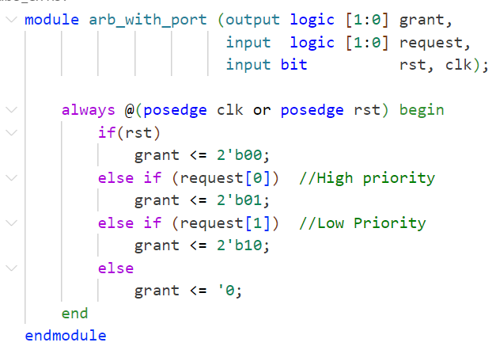
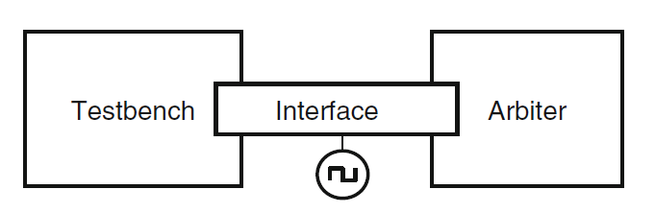
Lab Task
Develop a SystemVerilog test program to test the DUT (arbiter.v).
1) Develop SystemVerilog testbench files
2) Compile and simulate with VCS
3) Verify Simulation results using DVE

Slide 28
Lab Task: Steps
For the given DUT create an interface to connect the test program to the router (arbiter_io.sv)
Declare a clocking block and modport as needed.
Optional: add specifications for input and output skews.
Write the test program (test.sv)
Include arguments that connect to the modport in the interface block
Print a message to the screen inside the initial block, ex: “Hello World!”
Connect everything in a harness file and include a simple clock generator (arbiter_test_top.sv)
Compile all files with the following command (using VCS):
vcs -sverilog arbiter_test_top.sv test.sv arbiter_io.sv arbiter.v
VCS will compile the files and create an executable file called simv
Simulate by executing the binary created by VCS
./simv
Check to see if the $display message appears.

Slide 29
Lab Assignment

Slide 30
Lab Assignment: Steps
Edit your test program (test.sv) to include the following:
reset the DUT
drive the arbiter
Run the simulation using DVE
dve &
File -> open database -> test.vcd
To generate the vcd file add the following in (arbiter_test_top.sv):
initial begin
$dumpfile(test.vcd);
$dumpvars;
end

